Slide 1
Orders Analysis Report

Slide 2
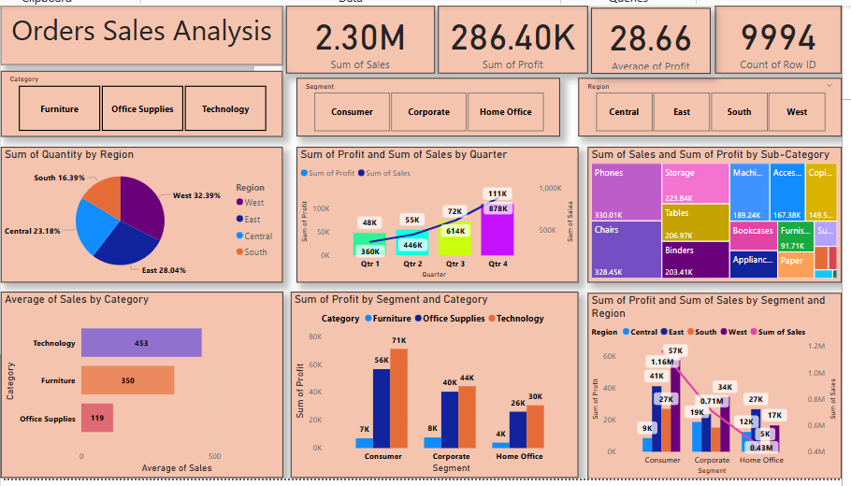
Introduction:This report summarizes the insights derived from the "Orders Analysis" dashboard. The visualizations provide a detailed overview of sales performance, profit distribution, and customer segmentation.

Slide 3
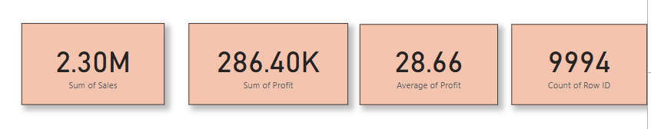
Key Metrics:Total Sales: Shows the overall revenue generated.
Total Profit: Reflects the profitability of operations
Average Profit: Indicates the mean profit per order
Number of Orders: Represents the total count of transactions.

Slide 4
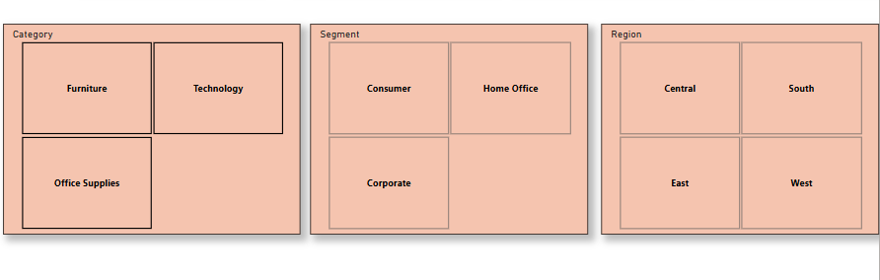
Filters:Categories: Allows for analysis of performance by product categories (e.g., Furniture, Technology, etc.).
Customer Segments: Segments the data into groups such as Consumer, Corporate, and Home Office.
Regions: Breaks down metrics by geographic regions (e.g., West, East, etc.).

Slide 5
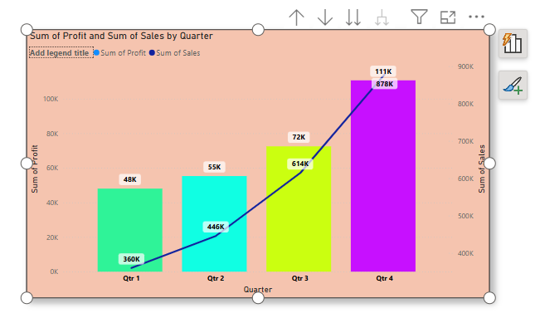
Insights from Visualizations
Sales and Profit Trends by Quarter : In this visual we can also drop down to months , days and years, A clear visualization of seasonal performance patterns, Insights from Visualizations
Performance by Region : Quantity Produced by each region

Slide 6
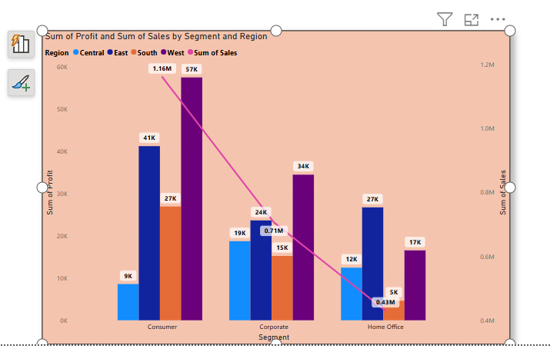
Performance by Region and Segment:
Sales and profits distributed across different regions and Segment.
Highlights the Segment and regions contributing the most to revenue and profit.

Slide 7
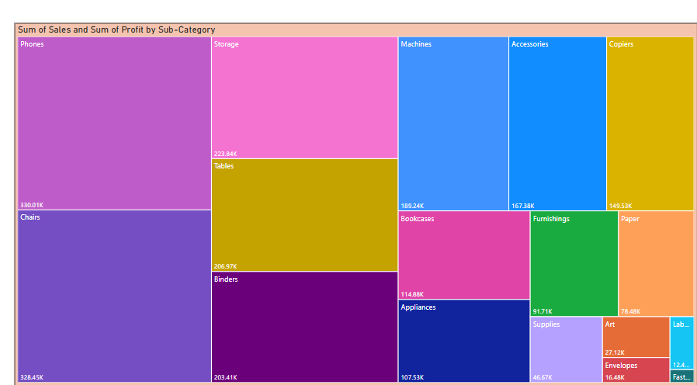
Sales and Profit by Product Sub-category:
Detailed analysis of individual product sub-categories.
Identifies which sub-categories generate the highest sales and profit.

Slide 8
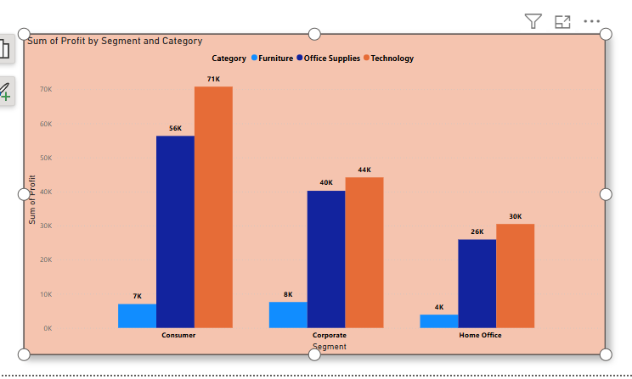
Category wise Segment Analysis:
Evaluates sales and profit metrics for each customer segment.

Slide 9
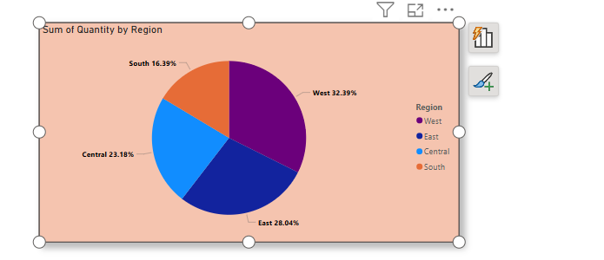
Quantity Produced By Each region

Slide 10
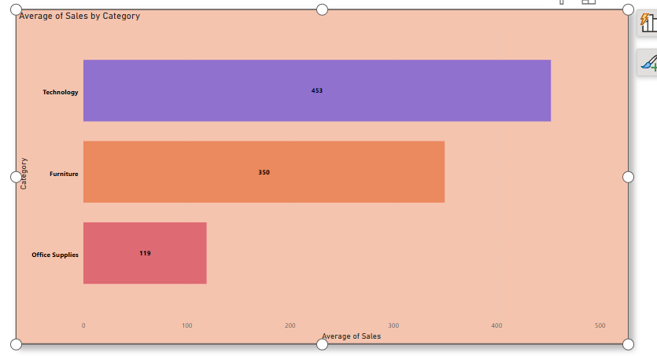
Average Sales by Category

Slide 11
Conclusion
The dashboard provides actionable insights into sales trends, regional performance, and customer behavior. These findings can help guide decision-making for inventory management, sales strategies, and customer targeting.

